Slide 1

Automated Green House
POC Project - 18/12/2019
Marie Willem –Lindsey Orville- Mélanie Ngo- Ellen Mathiesen NE2/A4

Slide 2
Actual Problem
Purpose
Demonstration
How does it work ?
Features
Perspectives
Table of Contents

Slide 3



Green House Actual Problem

Slide 4
Purpose
Check all features : Light, Temperature, Air Humidity
Adjust them
Send alerts when the system is out of limits
Send a weekly report
Notes:
Check all features : Light, Temperature, Air Humidity : 7d/7 and 24h/24
Adjust all features
Receive Alert Message if we are outside limits of our system (too warm, too dark, ….).
Receive by email a Report (each week), with : recap of Alert messages ; Middle Light, T° and Humidity of the day

Slide 5
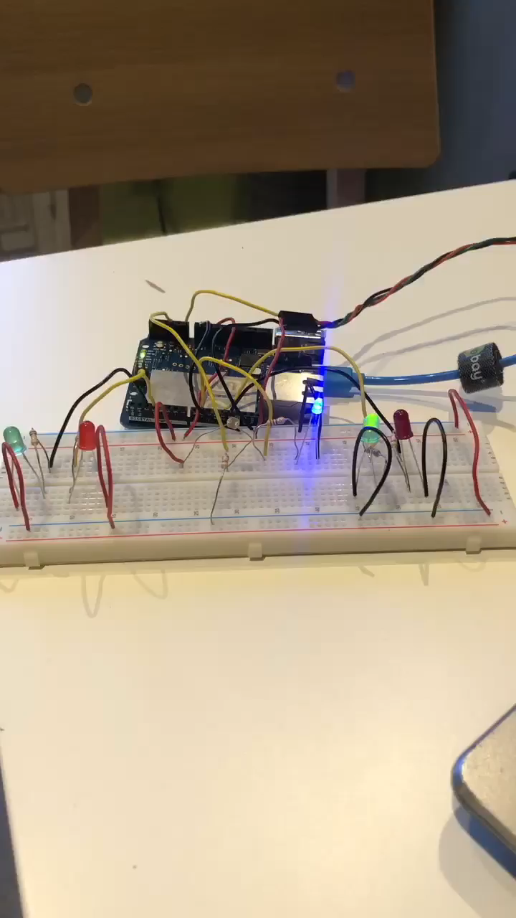
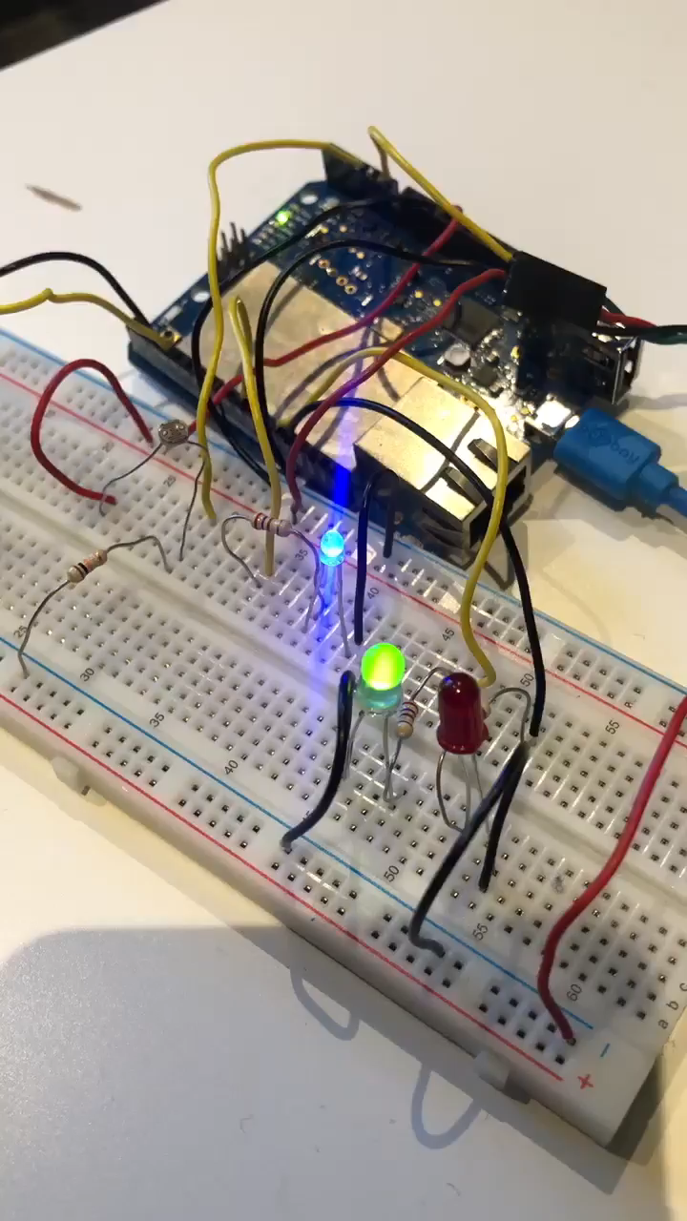
Demonstration

Slide 6
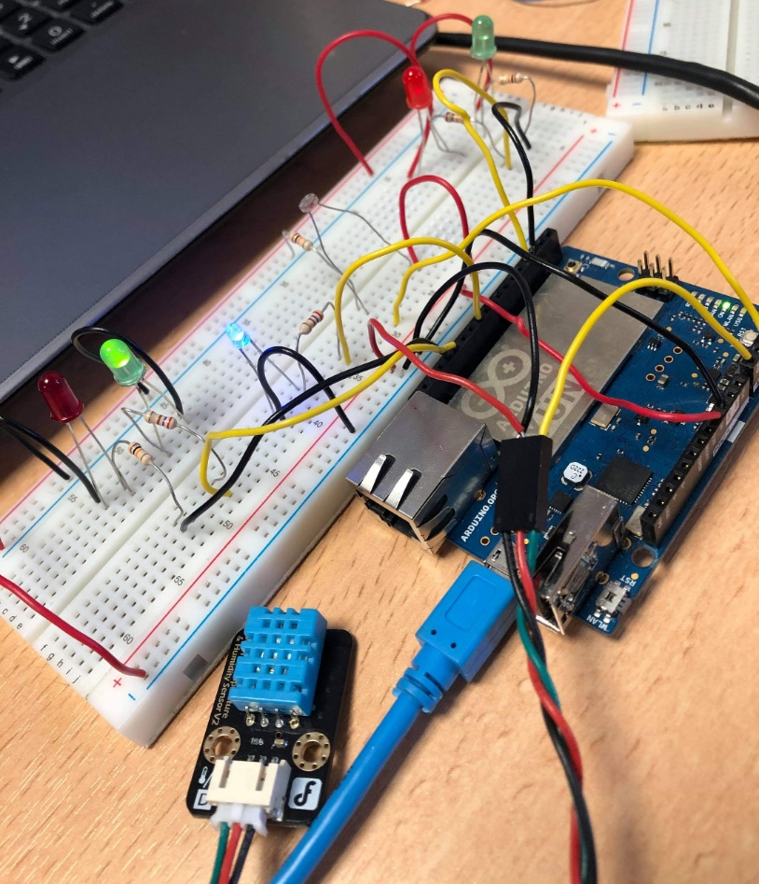
Demonstration Global system
Combining LDR and DHT11 sensors
Combining codes

Slide 7
How does it work?
General Diagram
Temperature Conditioning value (Hot & Cold)
Database
DHT 11
Temperature &
Humidity sensor
ADC
Humidify
value
Web
Server
Raspberry
Arduino YUN
PWM
LDR
photoresistor
Light value
Heater, humidifier and light Regulation

Slide 8
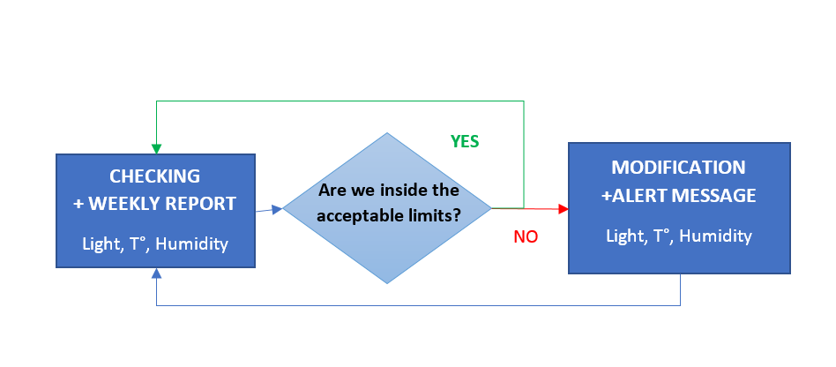
How does it work ?
General Sensor Control

Slide 9
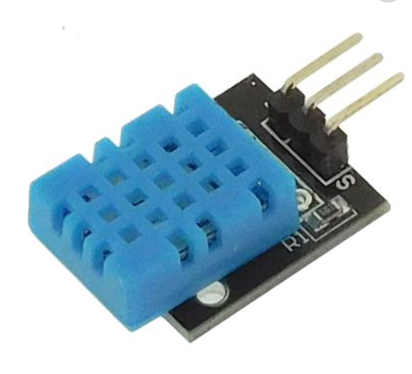


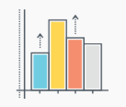



Features
Sensor tools
DHT11
Humidity + Temperature sensors
LDR
Light Sensor
WEB SERVER
Database & Monitoring

Slide 10
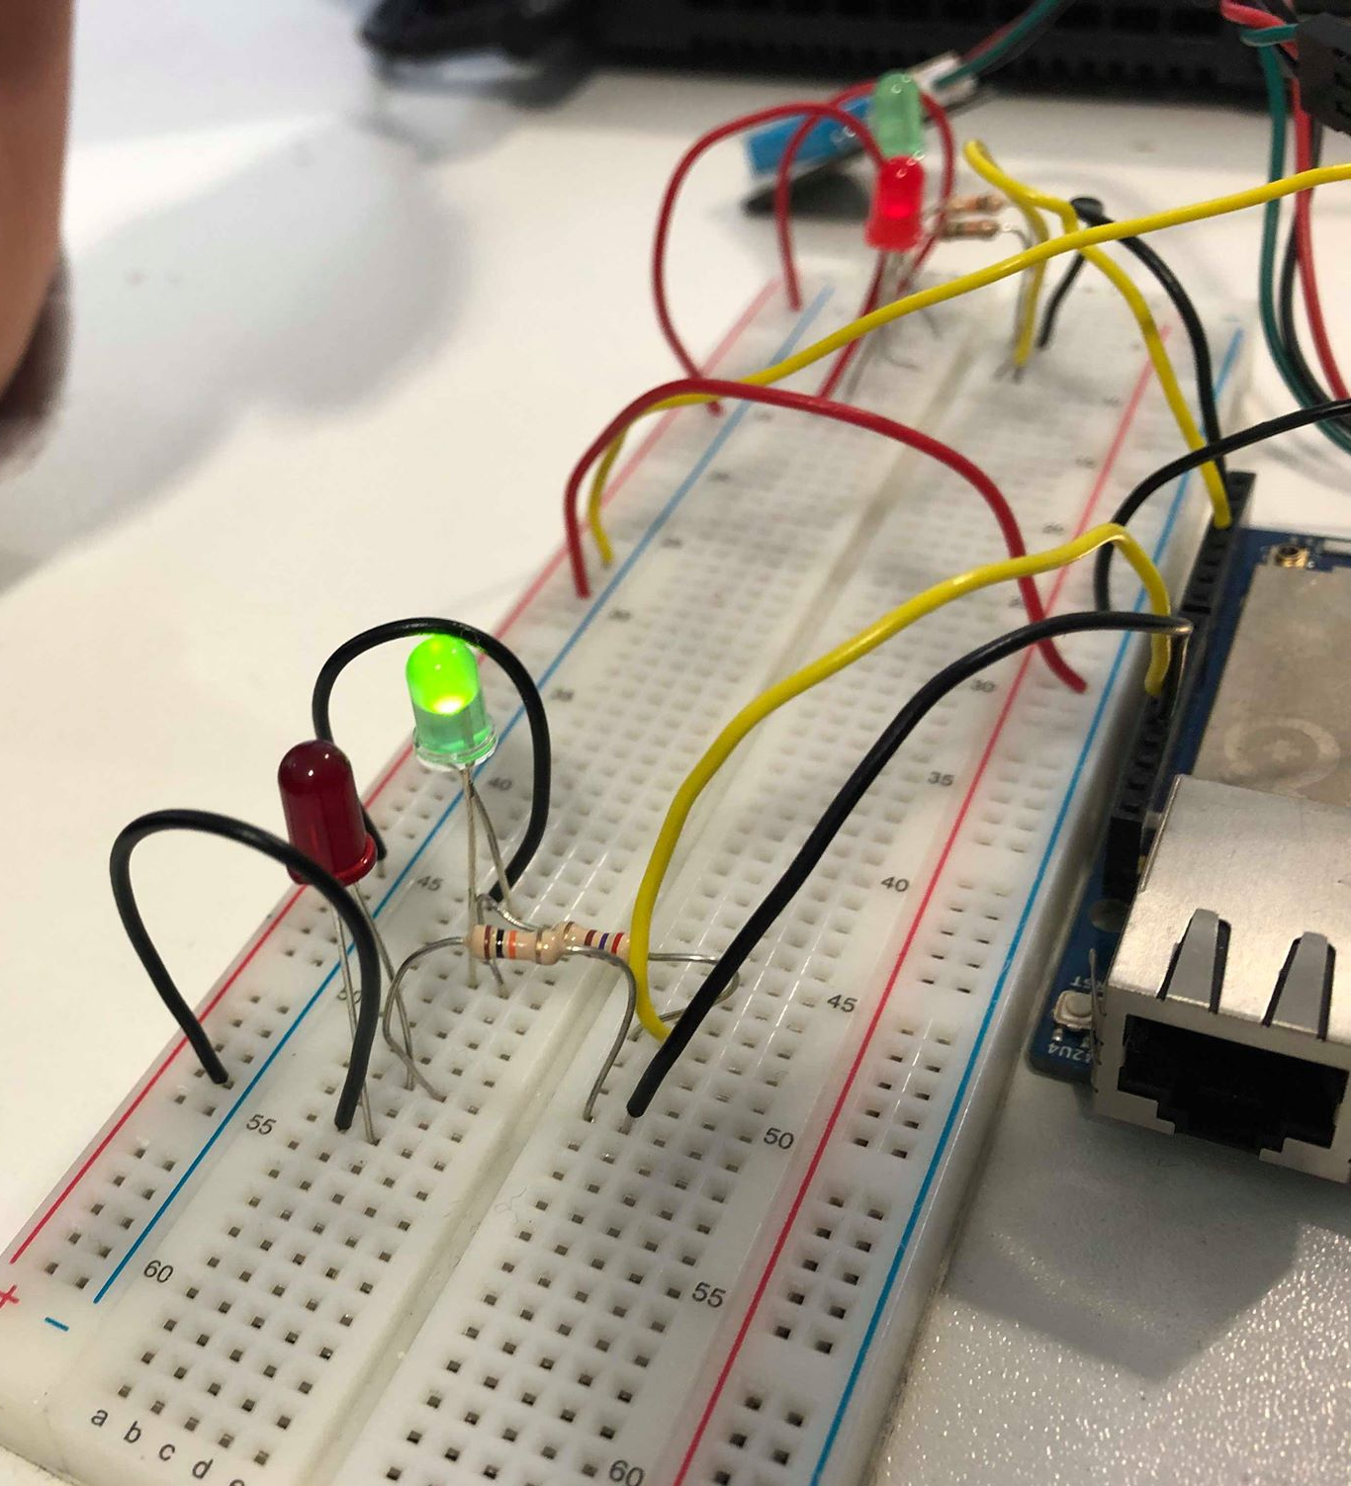




Features
DHT 11: Humidity and Temperature Sensor
Characteristics:
Air humidity : 41-80%
Conditions
HIGH VOLTAGE
LOW VOLTAGE
Action: Triggers air humidifier

Slide 11



Features
DHT 11: Humidity and Temperature Sensor
Characteristics:
Room temperature : 16-22°C
Conditions
HIGH VOLTAGE
LOW VOLTAGE
Action: Triggers heater

Slide 12
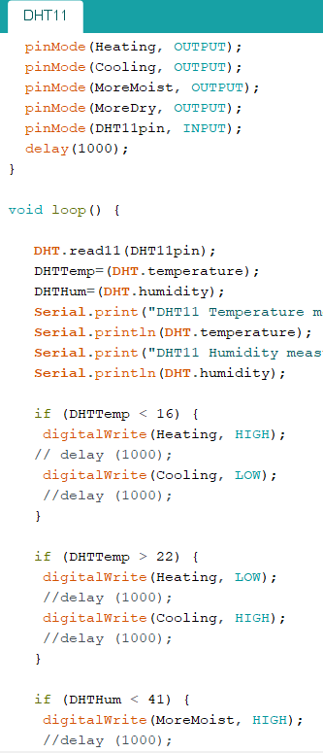
Features
DHT 11: Humidity and Temperature Sensor

Slide 13
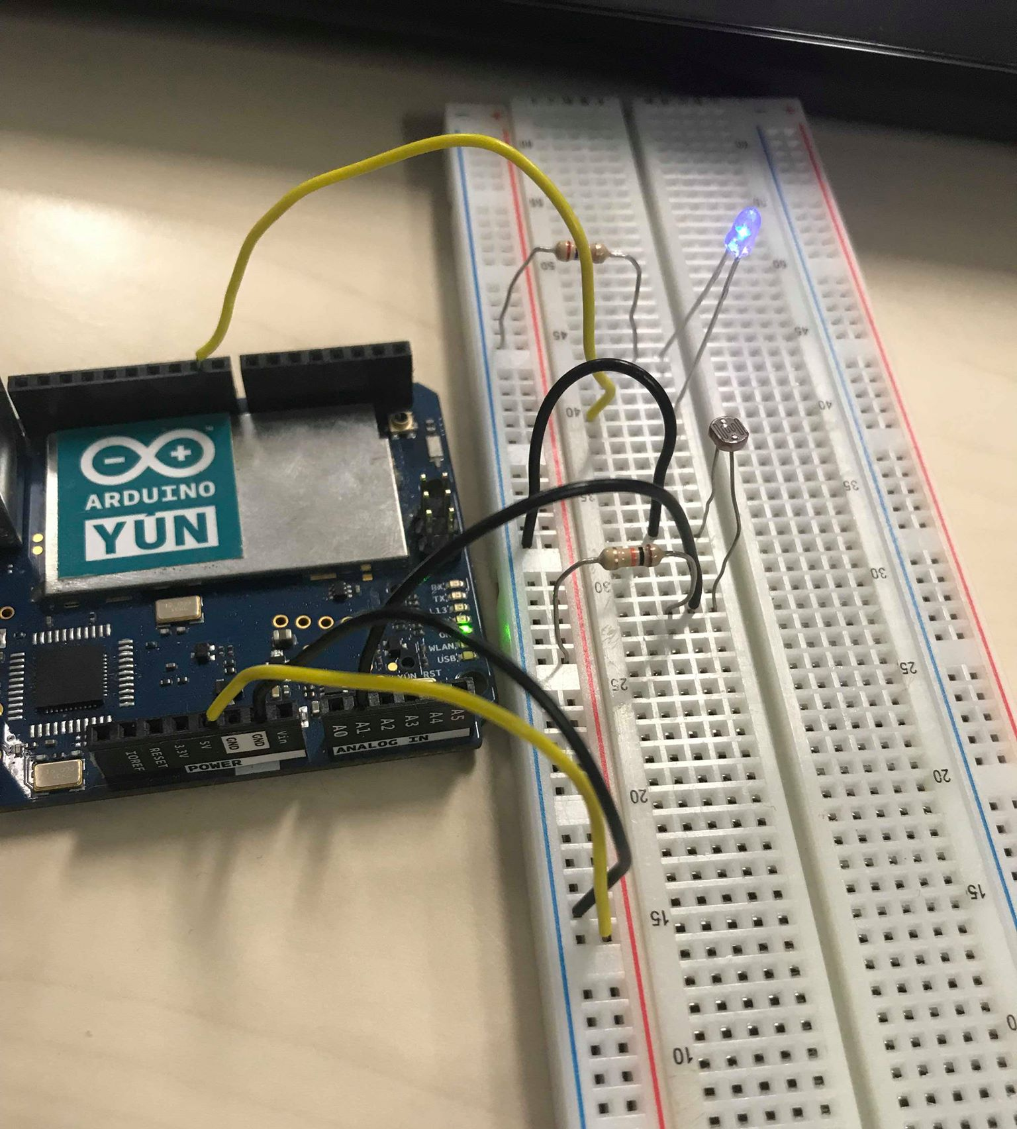






Features
LDR Sensor
Characteristics: LDR value : between 0 and 1023
Conditions :
High Intensity
Low Intensity
Action: Change light intensity

Slide 14
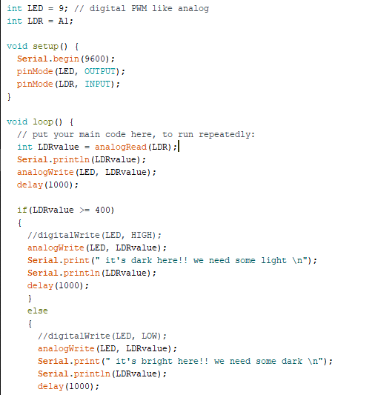
Features
LDR Sensor

Slide 15



Webserver & Database
Principles
Database
Web Server
Raspberry
Arduino Yun

Slide 16
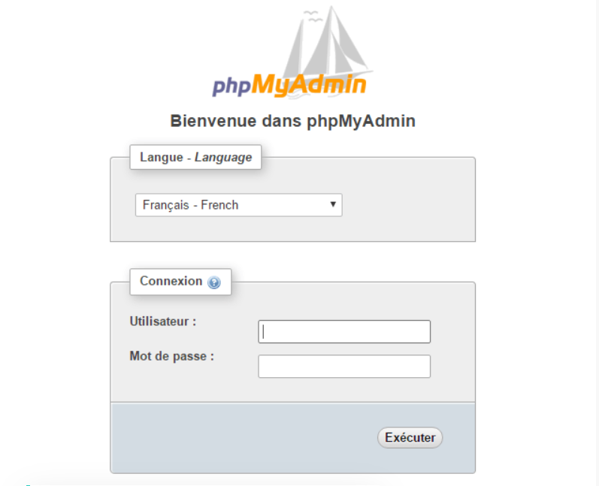
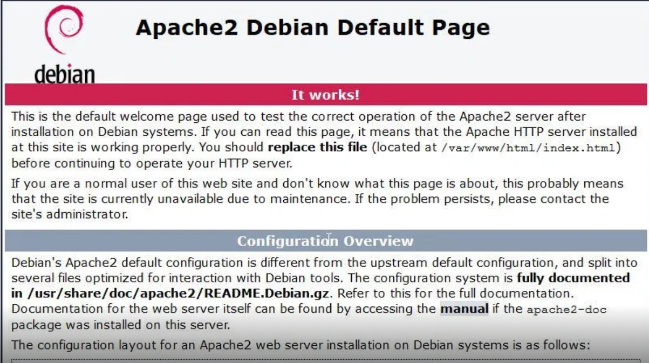
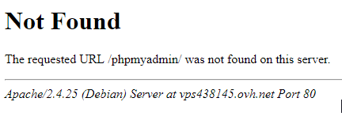
Webserver & Database
Project Process
...

Slide 17
Perspectives
Pushing data
Web Server
Raspberry
Arduino Yun
1
Web Server
Raspberry
Arduino Yun
2
3
Raspberry
Web Server
Arduino Yun
LCD screen

Slide 18
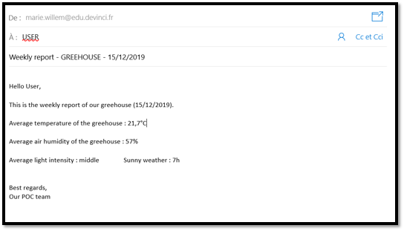
Alert message
Perspectives

Slide 19


